Slide 1

Virtual Drum Kit
By Chee Wei Xian (U2021644K)
Notes:
Hi everyone. My name is weixian.
I present to you my tinyML project, which I name it “Virtual Drum Kit”
As the name suggests, it is a drum playing tool - but without having a physical drumset

Slide 2
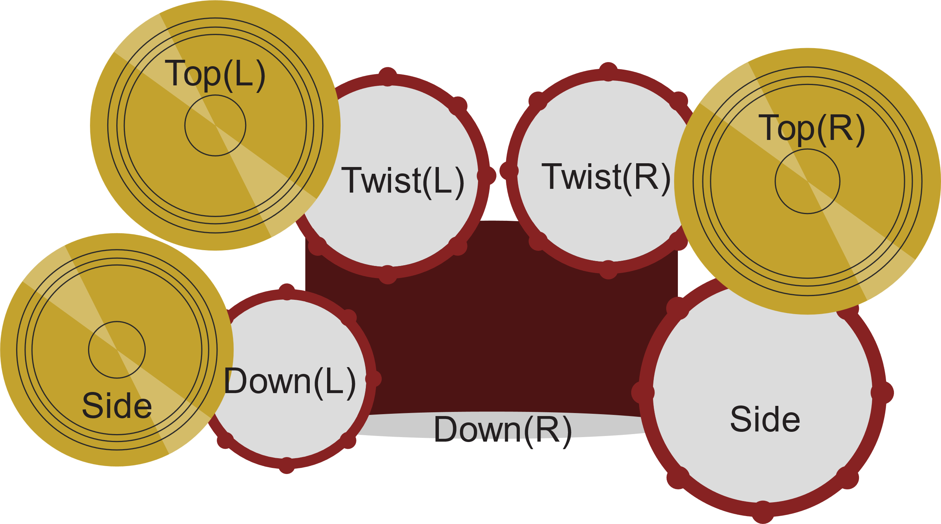
Notes:
I choose different type of gestures with each triggers a unique drum sounds. With all gestures together complete the virtual drum set.

Slide 3


Outlines
Hardware & Software used
Design Goal
Data Collection & Model Training
Inference accuracy vs Response time
Result
Learning Points
Demo

Slide 4
Hardware
2x Arduino Nano 33 BLE or Arduino Nano 33 BLE Sense board
4x rechargeable 18650 batteries
2x 18650 battery holders
A laptop

Slide 5
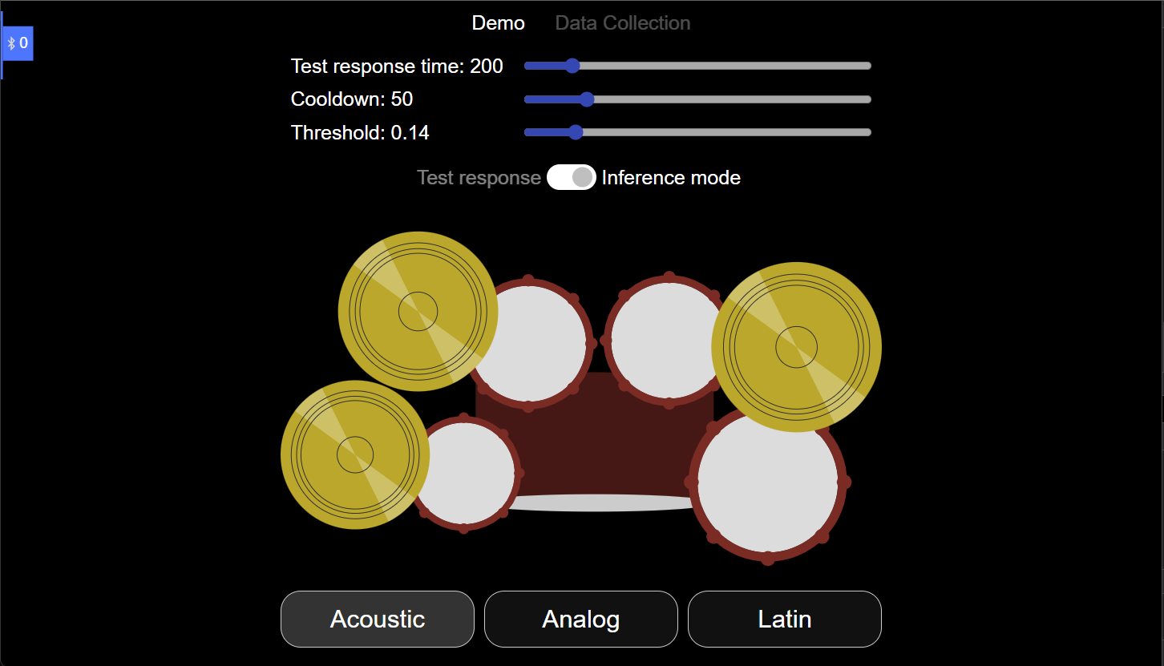
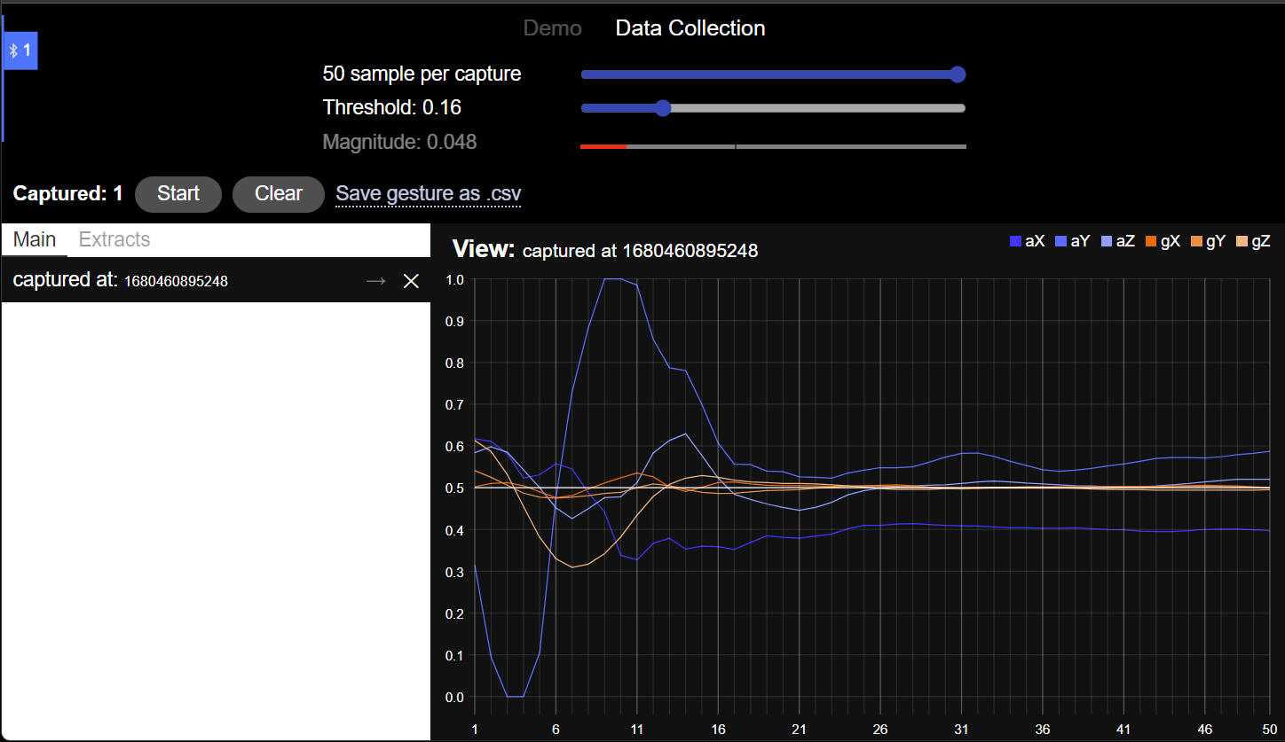
Software
A web application designed to play drum sounds and perform data collection
An executable run on Arduino to send/receive signal from the web app

Slide 6
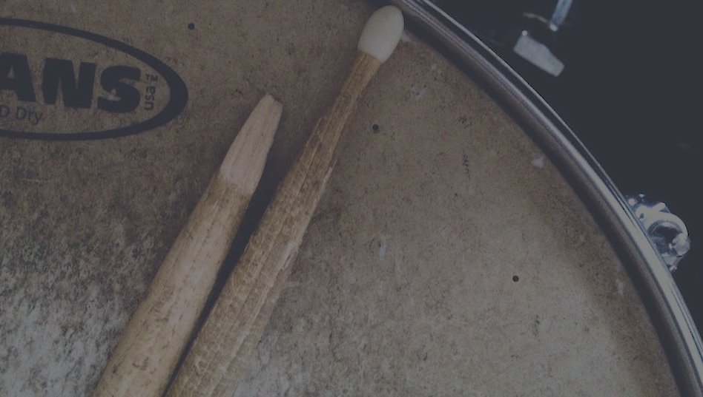
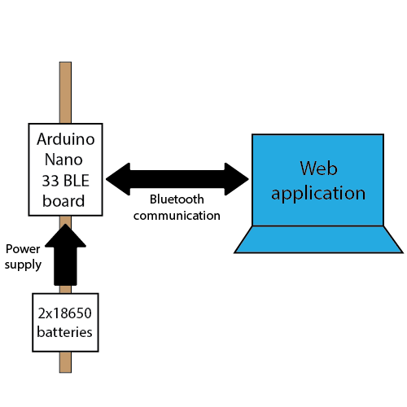
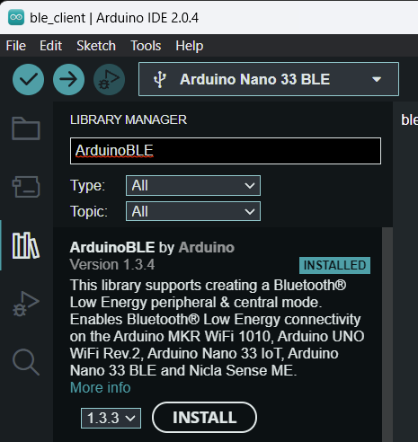
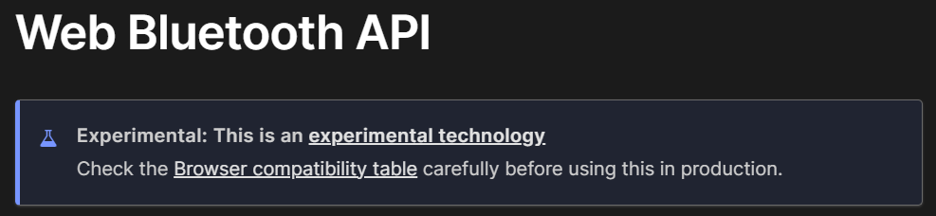
Notes:
Here is a simple block diagram that describe how different components communicate with each other
We have the Arduino board powered by two rechargeable batteries
The Arduino board and the web app communicate using Bluetooth.
On the Arduino board we use ArduinoBLE library to allow the board advertise its presense to the web app
On the web app, we gain access to the Bluetooth feature using Web Bluetooth API.
Once the communication is established, we are ready to perform data collection as well as sending inference result from the board to the web app.

Slide 7
Design Goal
Low latency in response to user gesture
High accuracy in inference
Notes:
Now, I have these two design goal in mind.
The first thing is to achieve low latency in response to user gesture, as it won’t be ideal for the user to only hear the drum sound 2 seconds after they make a gesture
The second thing would be achieving high accuracy in inference, we want the user to hear the drum sound that they expect.

Slide 8
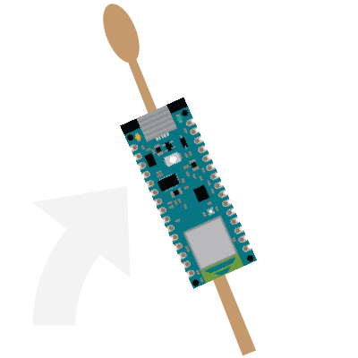


Design Goal – Low Latency
Threshold - trigger data sampling
Response time – time taken to play sound upon trigger
Data Sampling time
Inference time
0ms
150ms
Notes:
For low latency, it basically pivots around these two factors
First, determine a suitable threshold to trigger data sampling
Let’s look at the webapp where we can visualise the magnitude of the movement and from there, we can figure out a good threshold value.
Magnitude is basically calculated by adding all gyroscope and accelerometer datas, the value is then normalised to lie within the range between 0 and 1.
When my magnitude surpass the threshold, the bar changes its color to green telling me that the threshold is surpassed.
We don’t want the threshold to be too low, the board would be too sensitive, many false trigger will be called
We also don’t want it to be too high, user would be required to hit way harder to surpass threshold, bad user experience
After a few trial, I think 0.16 is a pretty good threshold value that is just right for this project.
Back to the design goal.
The second thing to be determined would be the response time. What exactly is a response time.
It is the time span between when you trigger the data sampling until you hear the drum sound on the webapp.
This is the delay between user action and user seeing the result, which is what we want to minimize to the point that they are unnoticeable or at least fairly acceptable.
Let’s look at the webapp again, I have a setting where I can do a quick test on the response time.
Let’s set the response time we want to test to somewhere close to 900ms
So 150ms will be the response time for the system to be considered responsive
Back to the slide, our response time will be 150ms minimum.
Within this time span, they are two main operation that dominates the response time, they are the data sampling time and inference time.
Which mean that the model configuration must be made to minimize these two timings.

Slide 9
Design Goal – High Accuracy
Data Collection
Model Training
Notes:
The next design goal would be achieving a high inference accuracy
That will depends on the clarity of collected data
As well as how well the model is trained

Slide 10
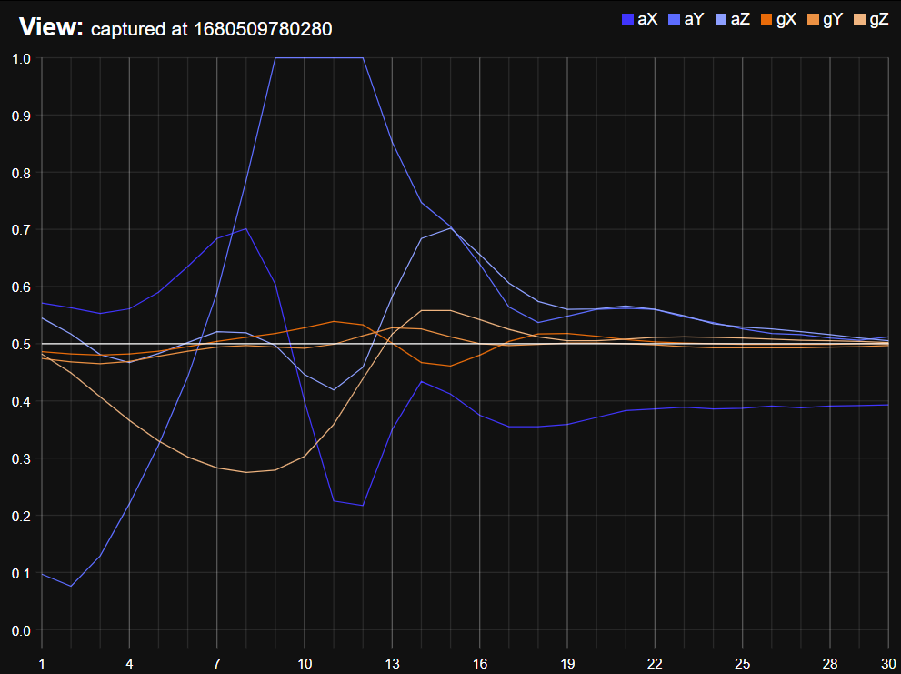
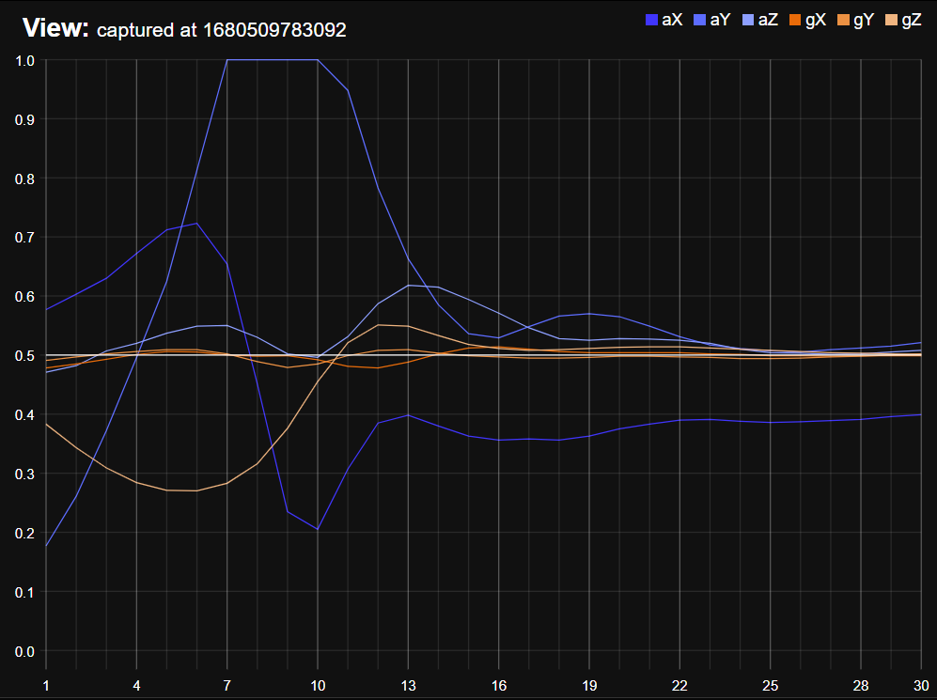
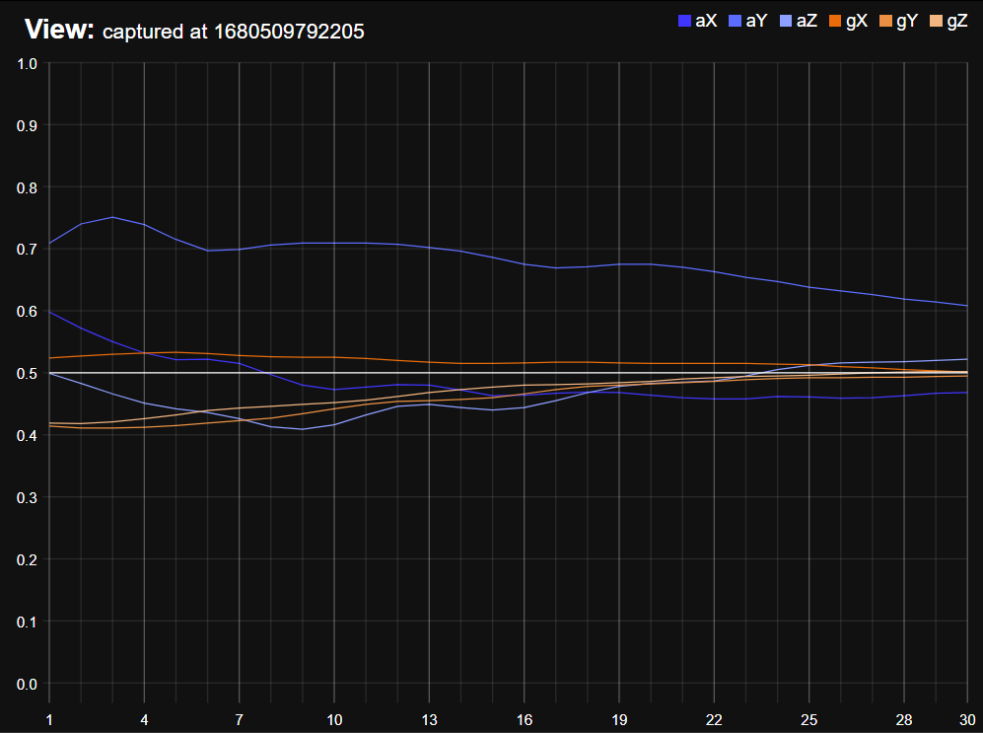
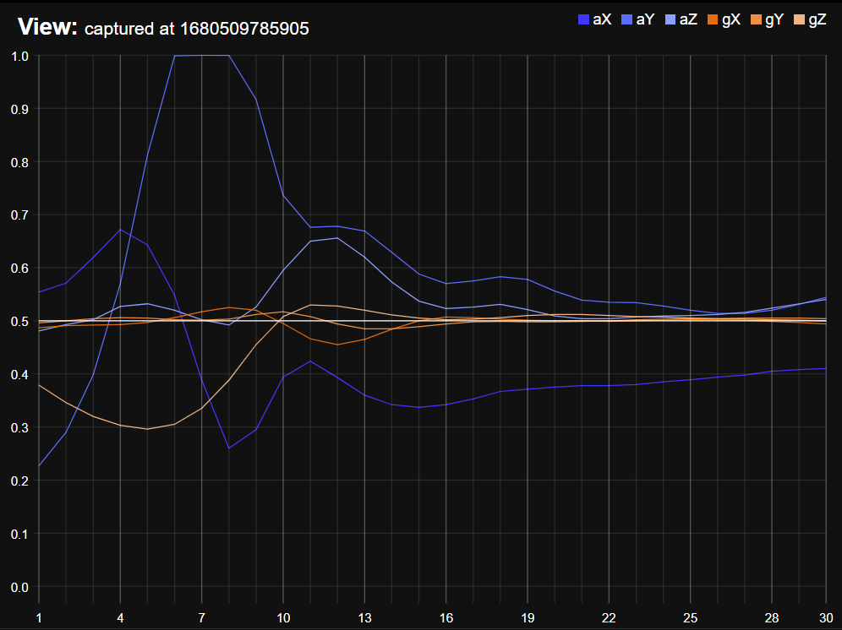
Data Collection
Sensor data for a “down” gesture
Notes:
The data collected to represented a gesture must be correct, sometimes we made mistake in data collection that some of the captured data do not represent the gesture at all,
Which may reduce the effectiveness in the later model training.
To make sure all captures can be easily verified, I have a data collection panel in the web app
Basically it allows me to visualise all captured data,
I can specify how many data point needed for a single capture, let say we do 50 sample of the 6-axis data.
Let do a few captures, also let’s purposely made a few wrong captures.
After the capture, we can verify if the data looks ok, like if there is any capture that is done accidentally, we can simply delete them or extract them to the side so later we can save them as an unknown gesture class.
Also, by visualizing the data, it gives me the idea of when the data converge, from here it is clear that the data converge around 30 sample,
Which suggest that perhaps we can make use of a smaller input size for our model, a smaller input size means lesser data to be sampled, which also reduce data sampling time and inference time.
Back to the slide
The next thing to achieve high accuracy is to construct a versatile model.

Slide 11
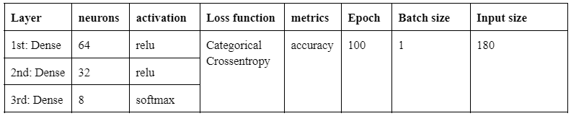
Model Training
Eight classes
Top(L), Top(R), Down(L), Down(R), Twist(L), Twist(R), Side, Unknown
320 captures in total
160 captures for training, 80 for validation, 80 for test
Notes:
The model is built for gesture detection, we have eight classes of gestures including an unknown class
40 captures per gesture had been made, with eight gesture classes in total, that means there are 320 rows of data available for training, validation, and test.
Here is a table showing the initial configuration of the model.
*Talk about the layers
For the loss function, I choose categorical crossentropy as it is designed for classification model.
And since each capture holds 30 sample, with each sample represent 6-axis data for gyroscope and accelerometer, that implies the model input size is 180.

Slide 12
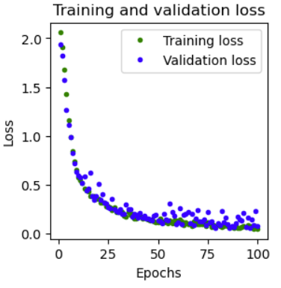
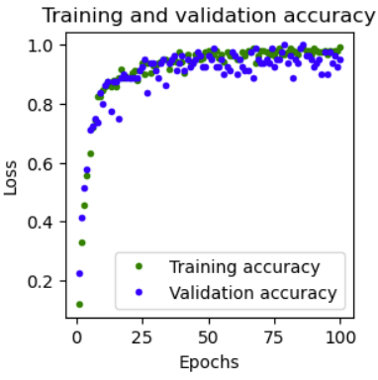
Model Training
Training/Validation loss (5-8%)
Training/Validation accuracy (95%)
Notes:
Here is the training performance
The training and validation loss converges about 5-8%
With the training and validation accuracy converges about 95%

Slide 13
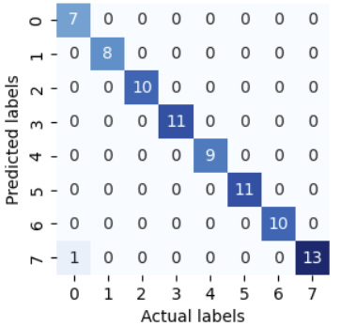
Model Training
Prediction on test data
79/80 correct prediction
Accuracy ✓
Latency <150ms?
Notes:
The prediction on test data also performs quite well, it achieves 79/80 correct prediction.
It shows that the initial model configuration has a good accuracy in predicting unknown data.
But is it good enough, how about the latency?

Slide 14
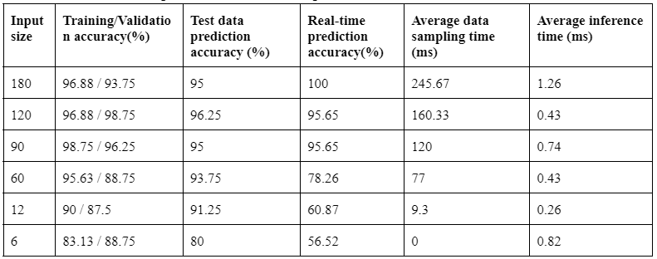
Accuracy vs Response time
Performance of models with different input sizes
Notes:
Using the same model configuration and retrain the model under different input size, it is shown that the initial model input size of 180 results in the worst sampling time of 245ms
which exceed our maximum response time 200ms. It also has a worst inference time among other input size.
If we try to improve the data sampling time by reducing the input size, an input size of 90 seems to have similar accuracy compare to those with greater input size,
While significantly reduce the data sampling time into 120ms, which allow the system to meet the response time criteria of 200ms.

Slide 15
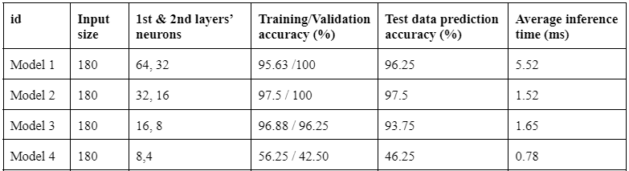
Accuracy vs Response time
Performance of models with different complexities
Notes:
But it is worth noting that data sampling time dominates the response time such that the increase in inference time due to a more complex model is negligible.

Slide 16
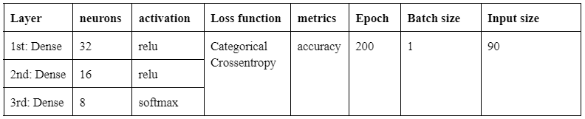
Results
Model adjustment to improve accuracy and reduce data sampling time
Notes:
Based on the comparison among model complexities, accuracy and response time. Here is the final model configuration that focus on reducing input size while preserving the prediction accuracy.

Slide 17
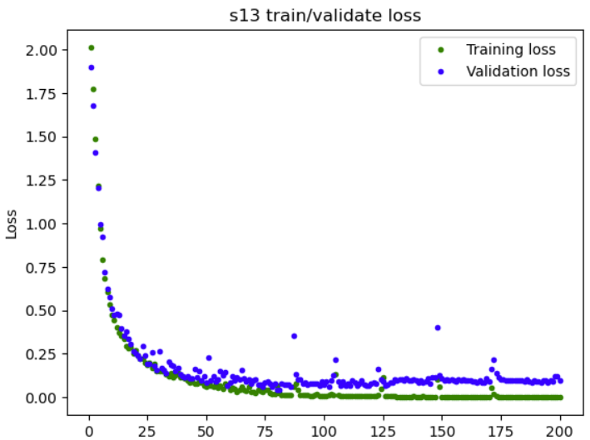
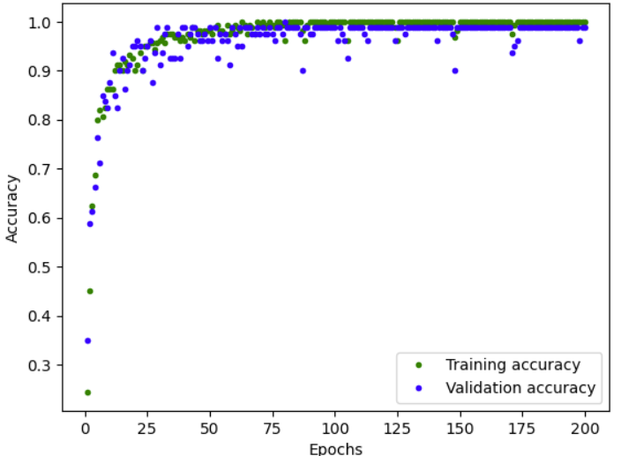
Results
Training/Validation loss
Old model: 5%/8%
New model: 0%/5%
Training/Validation accuracy
Old model: 95%
New model: 98.75%
Notes:
The new model shows a increase in accuracy in most cases.

Slide 18
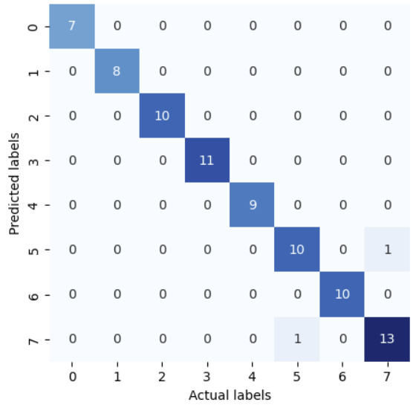
Results
Correct prediction on test data
Old model: 79/80
New model: 78/80
Notes:
Sharing similar prediction accuracy on test data

Slide 19
Results
Response time
Old model: 247ms
New model: 128ms < 150ms
Header file size
Old model: 349 KB
New model: 99 KB
Notes:
The response time has significantly improve to about half the old model response time, with header file size reduced into just 30% of the old model’s size

Slide 20
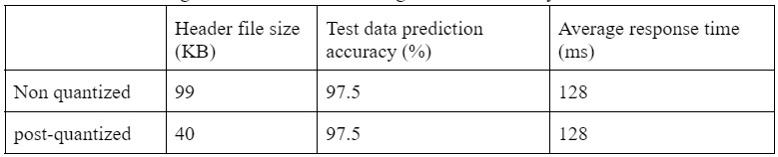
Optimizations
Real-time performance
Effort made in reducing data sampling time contribute to the responsiveness of the system
Power saving
Current spike during inference
Reduce model complexity and data sampling time leads to lesser time spent in activate state, which reduces energy consumption
Quantization
Header file size reduction with insignificant performance change

Slide 21
Learning Points
Prioritise on reducing input size over model complexity
Input size dictates the model code size
Data visualization
Do not assume data is correct, verify with your own eyes!
Be careful when using helper function
Create and destroy String() object causes heap fragmentation
Heap overflow => program behave abnormally
snprintf
char buf[max_size]

Slide 22
Demo

